Slide 1
Coffee Shop Aspirations
By: Simon Serrano

Slide 2
Overview
The Premise
Essential Elements of Analysis
The Beer Proxy
Results
A Café Prospective

Slide 3
Section 1:
The Premise

Slide 4


The Premise
This data science project consisted of identifying the best market to open up a coffee shop.
Fundamentally, the goal was to utilize data on per-capita coffee consumption as well as location data from Foursquare to understand which capital cities around the world have a high demand for new coffee venues.
Factors such as consumption, on-premise vs. off-premise purchase, and current prevalence of coffee shops were key points of interest in the analysis.

Slide 5
Section 2:
Essential Elements of Analysis

Slide 6
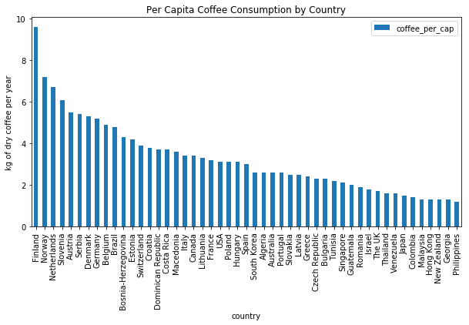
Consumption
To start, we note the per-capita coffee consumption in top consuming countries around the world. Northern Europe tops the list
Note that this is dry coffee and so Finns consume about 2.5 cups per day! (under the standard measure of 10.6g of dry coffee per cup)

Slide 7
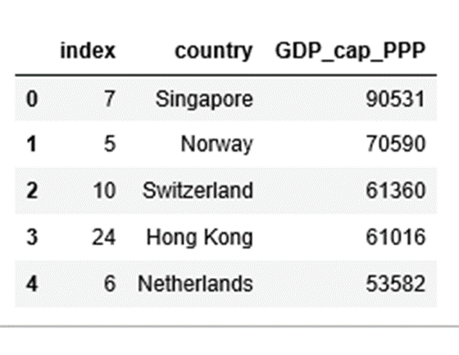
Economic Standing
Next, we look at per-capita GDP Purchasing Power Parity (PPP), which normalizes for different costs of living across countries.
This will be essential to estimating what percent of coffee is likely to be purchased at a shop (on-premise) versus bought at a market (off-premise)

Slide 8
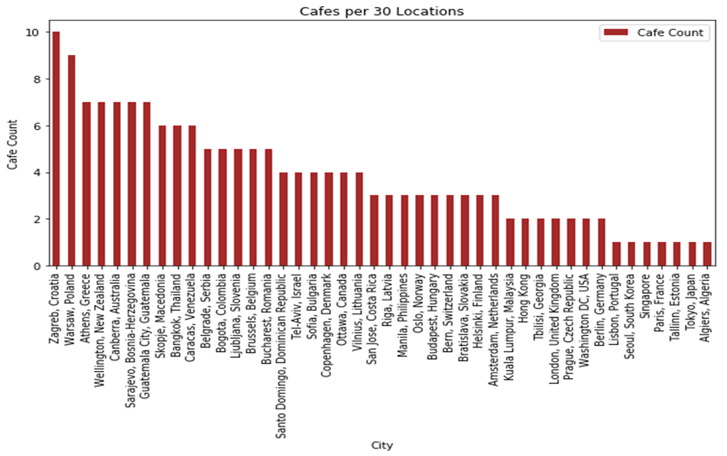
Nearby Cafes
We then use Foursquare location data to sample 30 locations within a 5-kilometer radius of the capital city of each country.
This gives us an idea of how concentrated the on-premise coffee market is in each country. We clearly see that a place like Zagreb would be a tough market to enter given existing competition.

Slide 9
Section 3:
The Beer Proxy

Slide 10

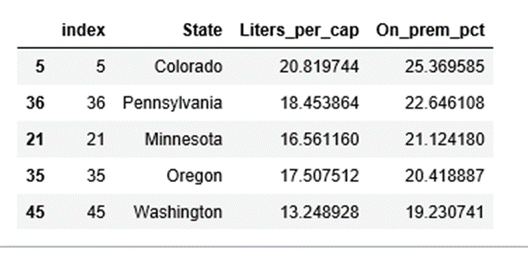
Motivation – What is a Proxy and Why Beer?
We don’t have on- versus off-premise data of coffee consumption across the world, but we can assume that the split of a similar good (beer) will be directionally analogous. And we have beer data in US states! So we can understand the effect of income on on-premise coffee consumption by way of analyzing income’s effect on location of beer consumption. This is estimation via proxy.
Note: We anchor our on/off coffee split with the one known (researched) point that 25% of coffee was consumed on premise in the US in 2004, when its GDP per capita was ~$42k.

Slide 11
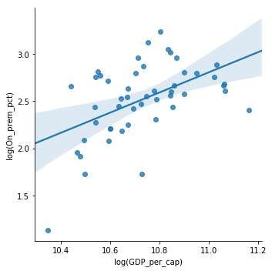
On-Premise Beer Consumption
The result of our log-log regression indicated to us that an increase in 1% of GDP per capita resulted approximately in a change of on-premise percent of 1.07%. Note this is a % change of a %!
This makes sense – On-premise consumption is almost always more expensive. Thus, higher incomes would result in the consumer substituting away from off-premise purchase and toward a premium experience.

Slide 12
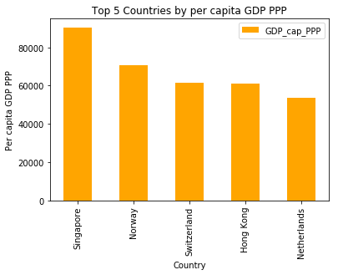
Example
Norway had a per-capita GDP of about $71k USD PPP in 2017.
This is (71-42)/42 ~ 70% higher GDP per-capita than the US when its on-prem coffee consumption was 25%.
This means that Norway’s on-prem coffee consumption should be approximately 1.7*25% ~ 43%.

Slide 13
Section 4:
Results

Slide 14
Optimization Metric
The following variables are used in deriving the optimal market for a café:
Café Count (CC) – Number of Cafes in the 30 point sample taken from Foursquare. Note that population density was not included as the points don’t necessarily encompass the same area everywhere. So we make the assumption that 30 locations covers the same population in each country.
Coffee per capita (CPC) – Average quantity of coffee consumed by person in a given country over a year
On-prem Fraction (OnF) – Fraction of coffee that is consumed on-premise, as opposed to off-premise
GDP-index (GI) – Maximum GDP PPP from all countries used to control for differences in on-premise pricing
Formula:
CC * CPC * OnF * GI

Slide 15
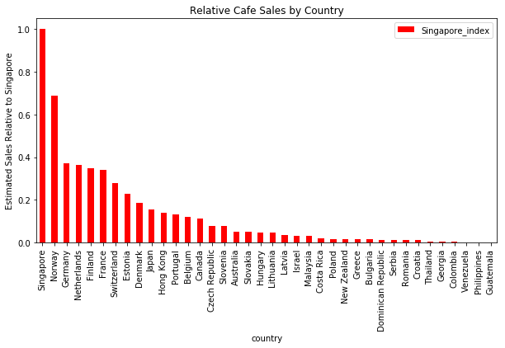
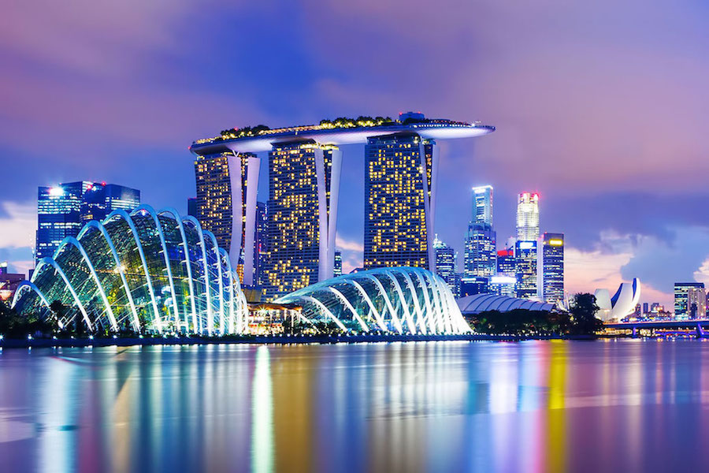
Drumroll Please…
The city with the highest value for the optimization metric defined was:
SINGAPORE!

Slide 16
Section 5:
A Café Prospective

Slide 17
Identifying Similar Markets
While we can see the optimization rankings of each country on the last slide, it is also neat to observe which cities resemble Singapore in terms of types of venues present (as identified by Foursquare). Such cities may end up being good opportunities in the future. To accomplish this, we utilized the K-means clustering algorithm and observed which cities were in Singapore’s cluster. They were:
Budapest, Hong Kong, Tokyo, Seoul, and Tbilisi!
Finally, we look at a graphic of this venue-based clustering…

Slide 18
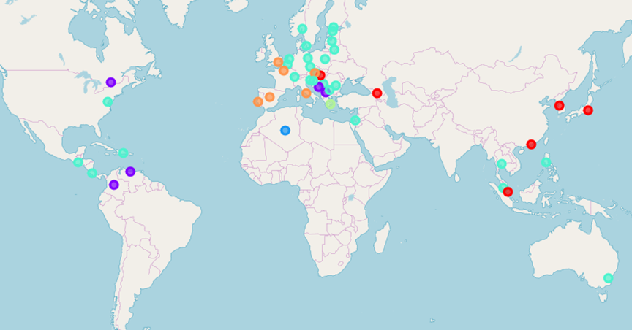
Results of Cluster Analysis
Singapore’s cluster can be seen in red. Generally, we see a segmenting of clusters by location. It’s neat that Singapore’s cluster is so geographically diverse, encompassing parts of East Asia, the Caucasus, and Central Europe.

Slide 19
Thanks for reading! Now enjoy a cup of coffee.

